Slide 1
IMDB Review
Sentimental Analysis

Slide 2


Meet our team
200522745
200566953
Purvi Rajubhai Patel
Bhanu Bhakta Bhattarai

Slide 3


Agenda
A
Introduction
How to perform?
Implementation
Challenges
Summary

Slide 4
Introduction
Sentiment analysis is a powerful tool used to analyze the sentiment behind textual data, providing insights into the emotions, opinions, and attitudes expressed within the text. It plays a crucial role in understanding public opinion, customer feedback, and social media sentiment, providing valuable insights for decision-making.

Slide 5
How to perform?
Sentiment Analysis Process

Slide 6
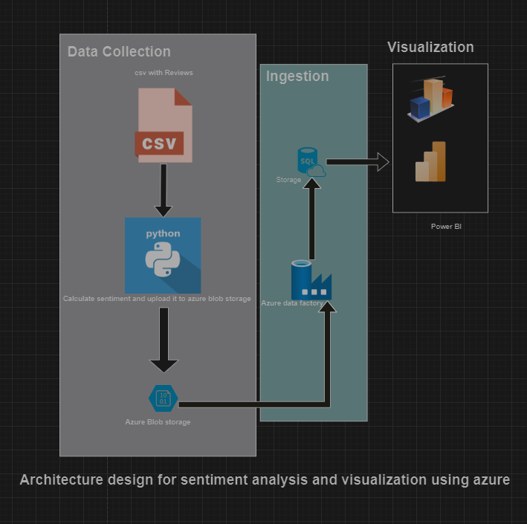
CSV : It’s a CSV file that contains reviews which need to be analyzed for sentiment.
Python: This file involves code for processing the reviews using a sentiment analysis algorithm.
Azure Storage: The sentiment scores are then uploaded in Azure Blob Storage, which is a service for storing large amounts of unstructured data, such as text or binary data.
Azure Data Factory: This is a cloud-based data integration service that allows to create data-driven workflows for orchestrating and automating data movement and data transformation. In this architecture, it’s used to process the sentiment scores in preparation for visualization.
Power BI: We will use to visualize the sentiment scores.

Slide 7
Implementing Sentiment Analysis Solutions
“
”

Slide 8
Data Source
The process begins with gathering textual data from sources such as social media, customer reviews, surveys, and news articles. For this sentimental analysis we have selected datastore from IMDB Review.

Slide 9
Text Pre-processing
The bellow code segment utilizes the Natural Language Toolkit (NLTK) library in Python to preprocess textual data for sentiment analysis.
It begins by downloading necessary NLTK resources such as tokenizers, WordNet for lemmatization, and a list of stopwords.
The function is then defined to clean and standardize the text. It removes punctuation, special characters, and stopwords, while also performing lemmatization to reduce words to their base forms.
This ensures that the text is in a consistent format suitable for sentiment analysis.

Slide 10
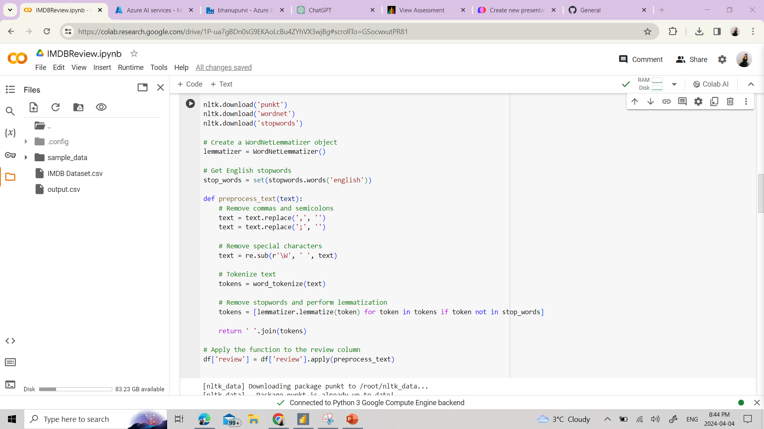

Slide 11
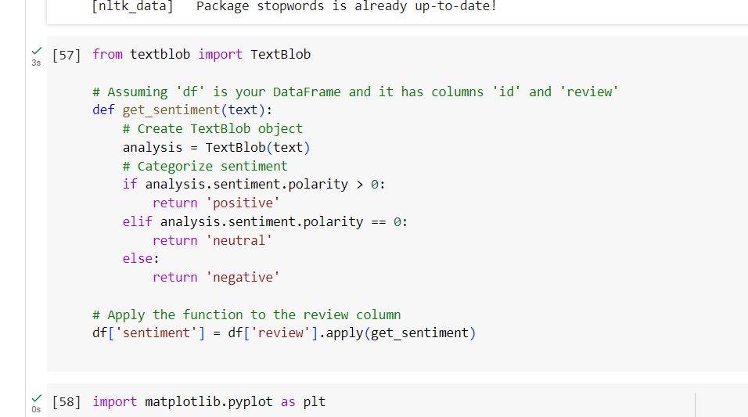
TextBlob
This code snippet show how we performed sentiment analysis using the TextBlob library in Python.
After importing TextBlob, a custom function `get_sentiment(text)` is defined to categorize the sentiment of each text input.
Within this function, the TextBlob object is created for the input text, allowing analysis of its sentiment polarity.
If the polarity is greater than 0, the sentiment is categorized as 'positive'; if it equals 0, it is categorized as 'neutral'; and if it's less than 0, it is categorized as 'negative’.
Finally, this function is applied to the 'review' column of the whole dataset.

Slide 12
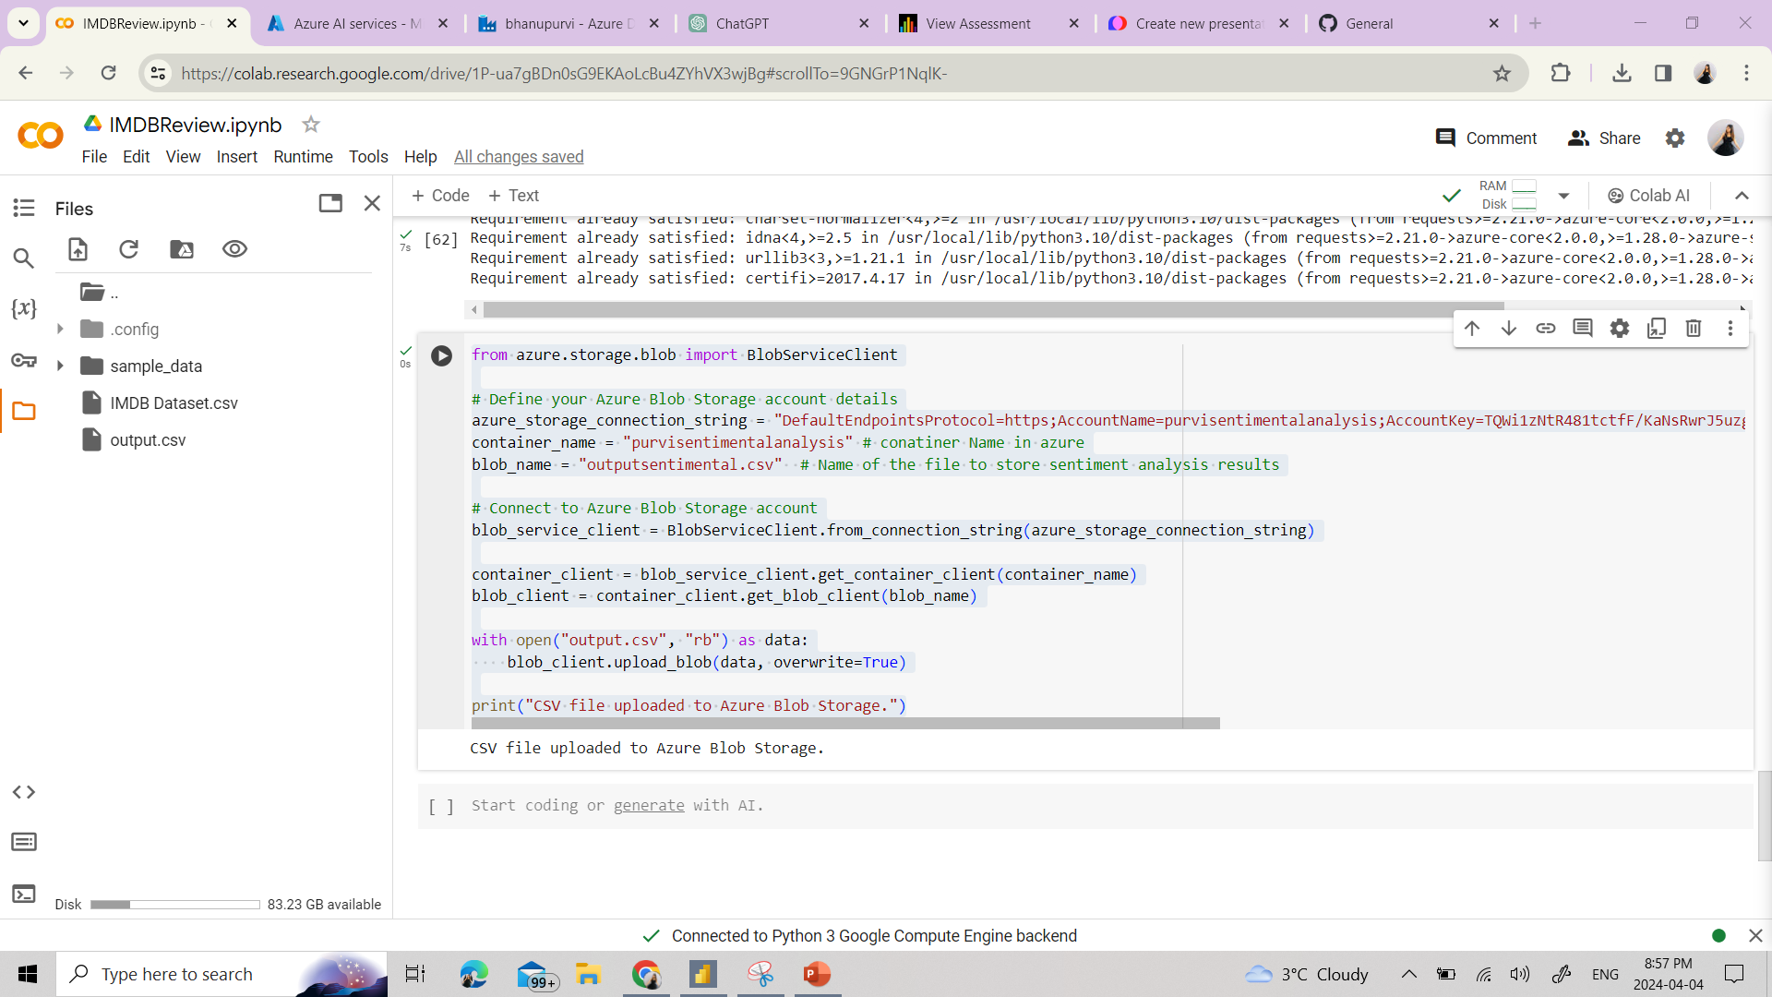
With this code we upload a CSV file to Azure Blob Storage using Python with the Azure Storage Blob SDK.
First, the Azure Blob Storage account details are defined.
The code opens the local CSV file ("output.csv") in binary mode, uploads it to Azure Blob Storage using the upload_blob method of the blob client, and overwrites any existing file with the same name.
This code is crucial for integrating the output of sentiment analysis into cloud storage, facilitating further analysis or sharing of results across different platforms.

Slide 13
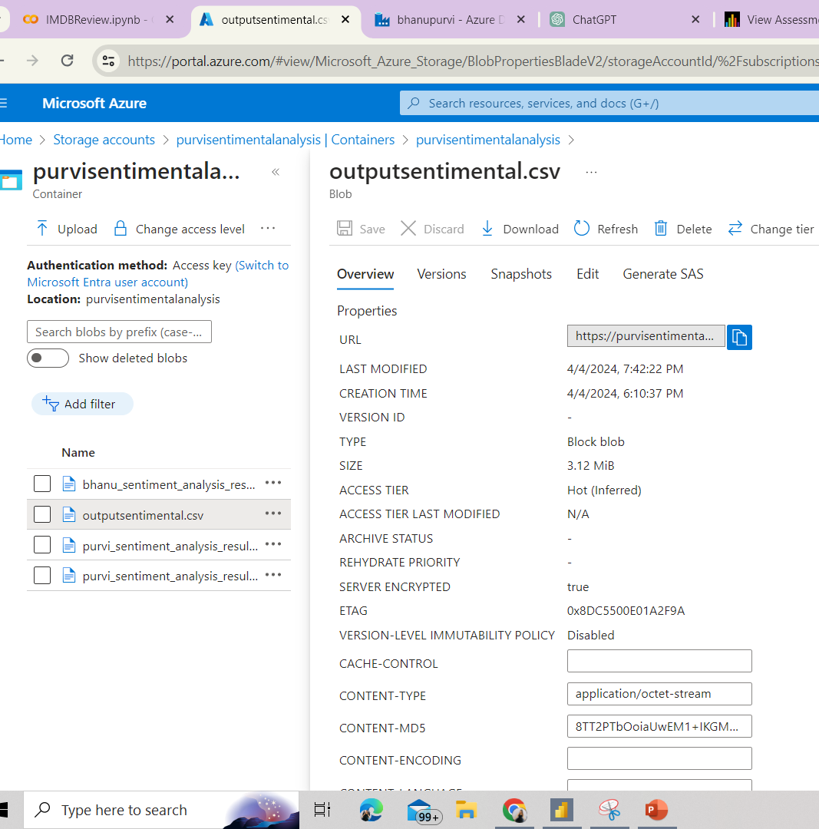
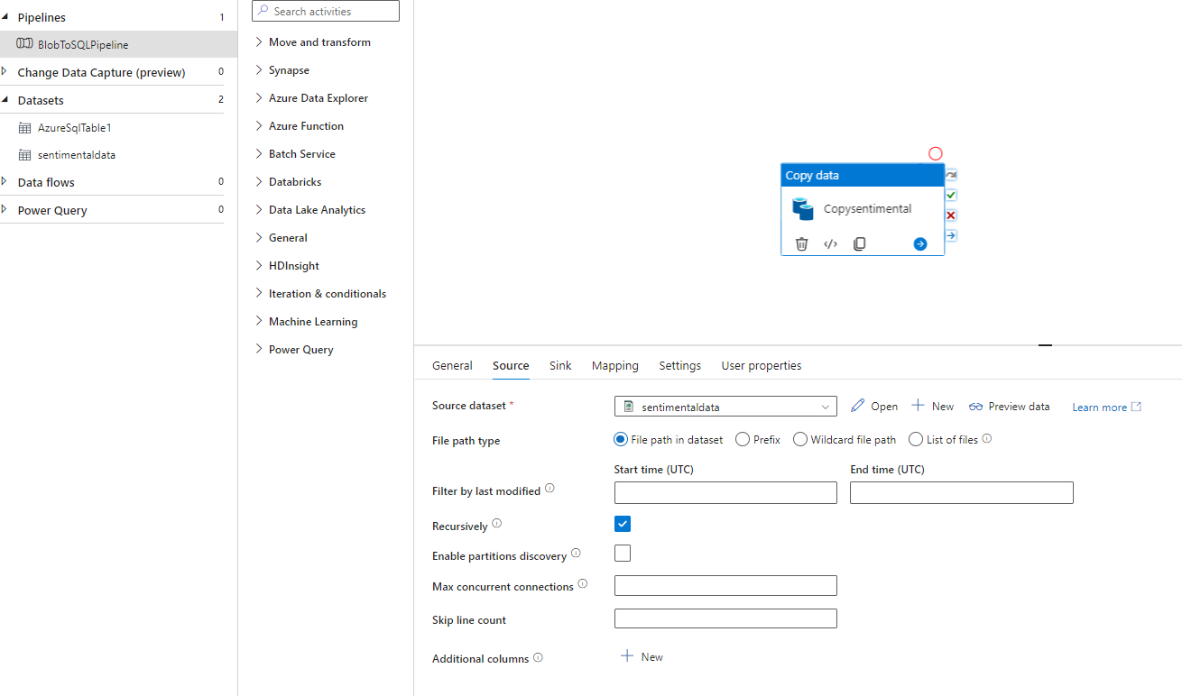
Azure Blob Storage
We created a pipeline to Data Factory.

Slide 14
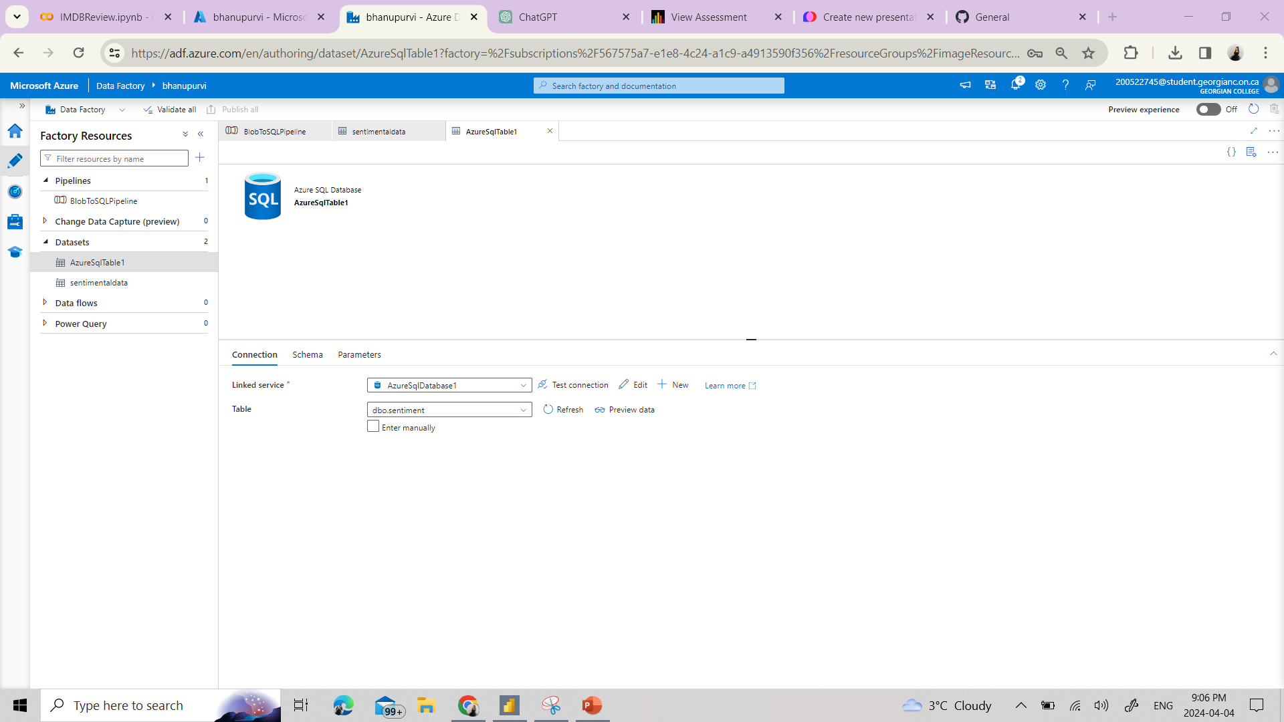
Azure Data Factory

Slide 15
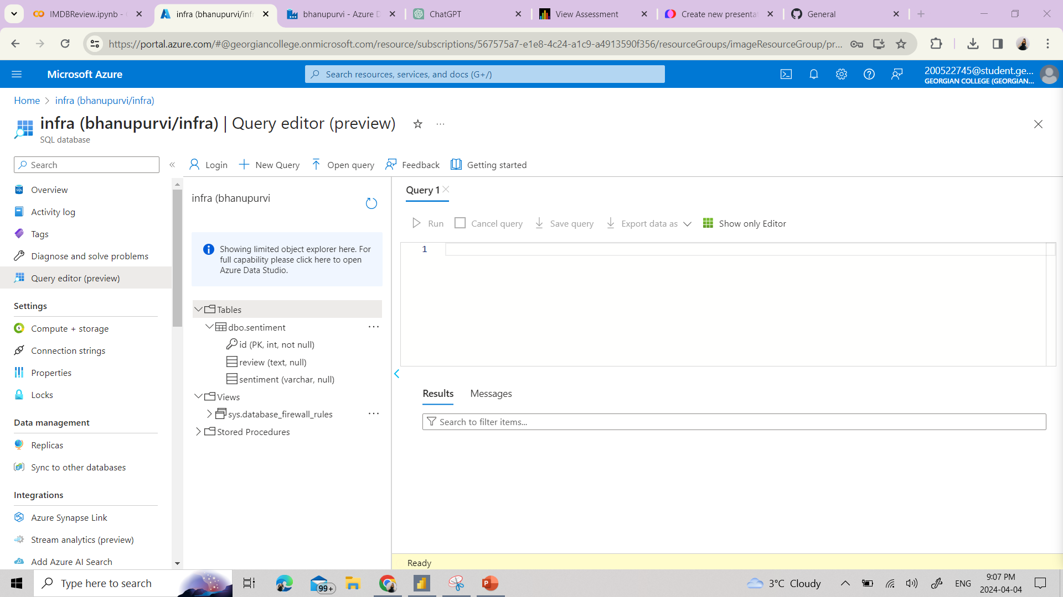
Azure SQL Database
Table was created in sql database to fetch data from data-factory.

Slide 16
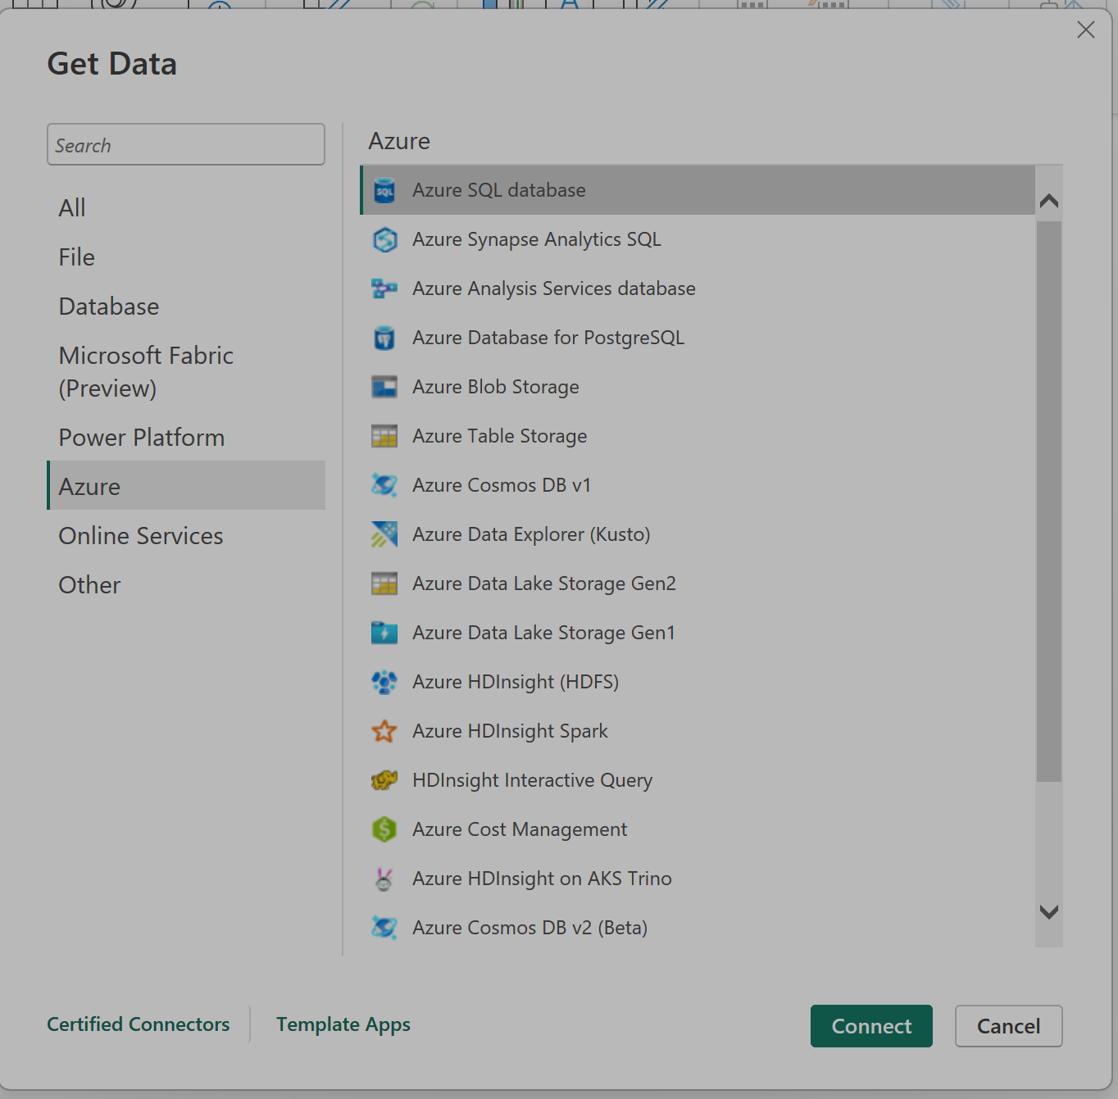
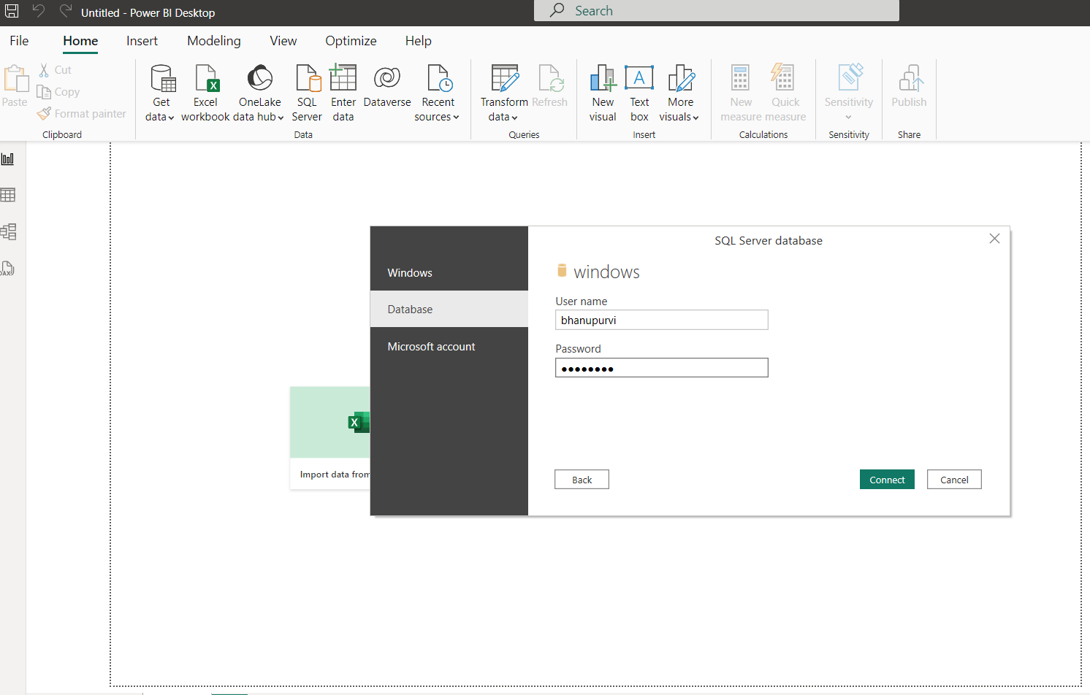
Power BI Connecting Azure SQL to Power BI

Slide 17
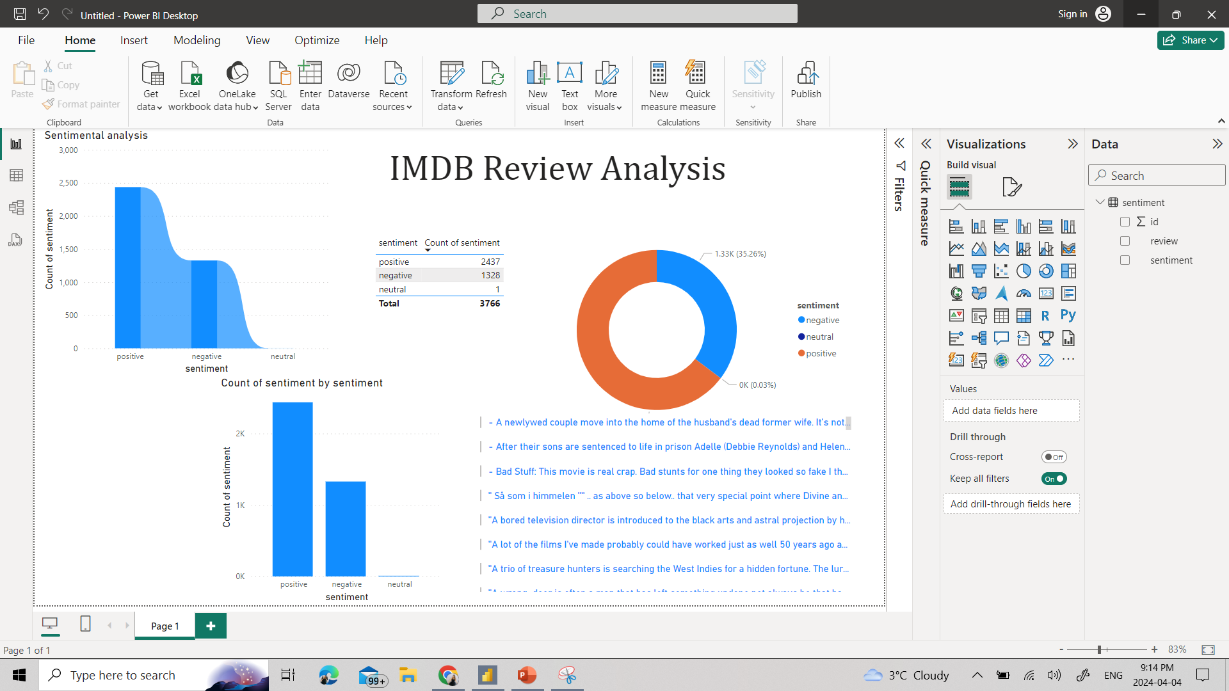
Power BI
We connected power BI to azure SQL Database for analysis.
We found total positive count of 5287 and Negative Sentiment1899, which is 73.6%, 26.4% respectively.
The sentiment analysis suggests that a significant portion of the IMDB reviews are positive.

Slide 18
Challenges
Preventing corruption or loss during transfer.
Ensuring secure access to Azure Blob Storage.
Troubled with transient errors, network interruptions due to firewall rule and public network, as well as timeouts during the upload process.

Slide 19
Summary
We performed tasks like uploading a CSV file to Azure Blob Storage using Python with the Azure Storage Blob SDK. Utilizing a text blob python library, and perform sentiment analysis on the acquired data. Azure Data Factory (ADF) was used to ingest the data into a preferred SQL database for storage. Finally, PowerBI was used to analyze and gain insights into the sentiment analysis results.

Slide 20
Thank you

